Slide 1
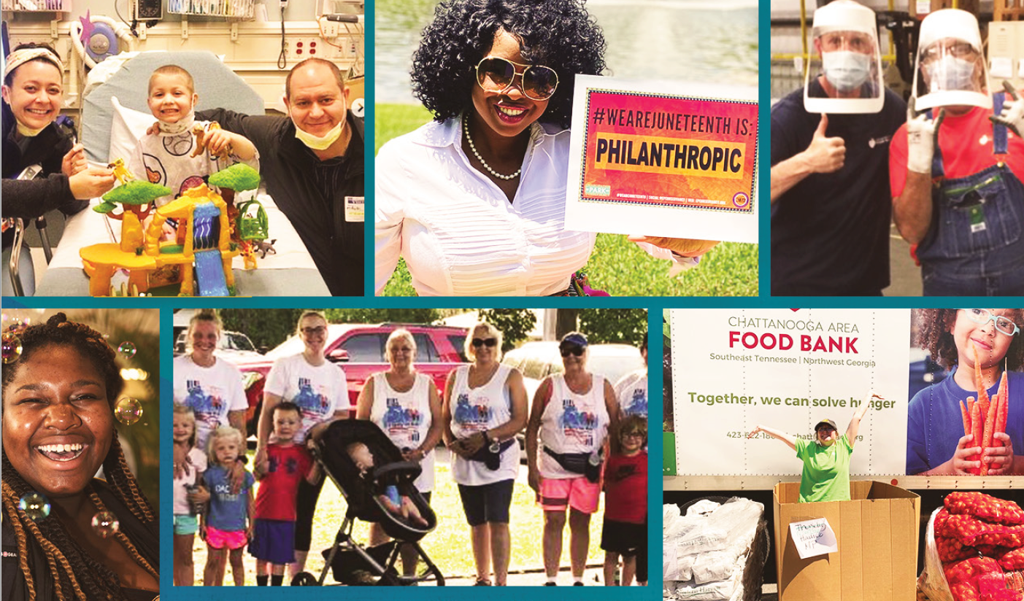

2023: Top Nonprofit Challenges &
How to Overcome Them
AFP ICON 2023

Slide 2


Welcome!
Emily Newberry
VP of National Accounts
OneCause
Karrie Wozniak
Chief Marketing Officer
OneCause

Slide 3
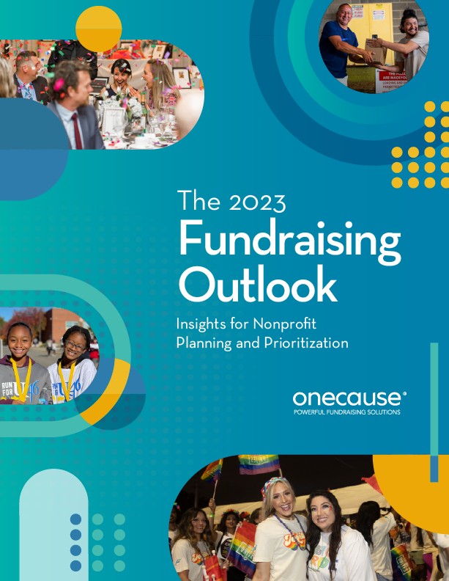
Agenda
About the Report
Challenges Overview
Nonprofit Challenges & Tactics to Overcome Them
Breakout
Wrap Up and Questions
Notes:
Let's take a quick look at what you can expect today
The challenges we’ll be talking about today come from our 2023 Fundraising Outlook Report, so well give some quick background on that. You'll also hear us mention some data from our donor-focused study, the Giving Experience.
Then we’ll take a look at how the nonprofits in the Report rated a group of challenges facing their organizations.
For a bulk of the presentation, we’ll be addressing the top 5 challenges and providing some solutions and tactics to overcome them.
We’ll have a quick interactive breakout and then have some time for Q&A. Let's go!

Slide 4
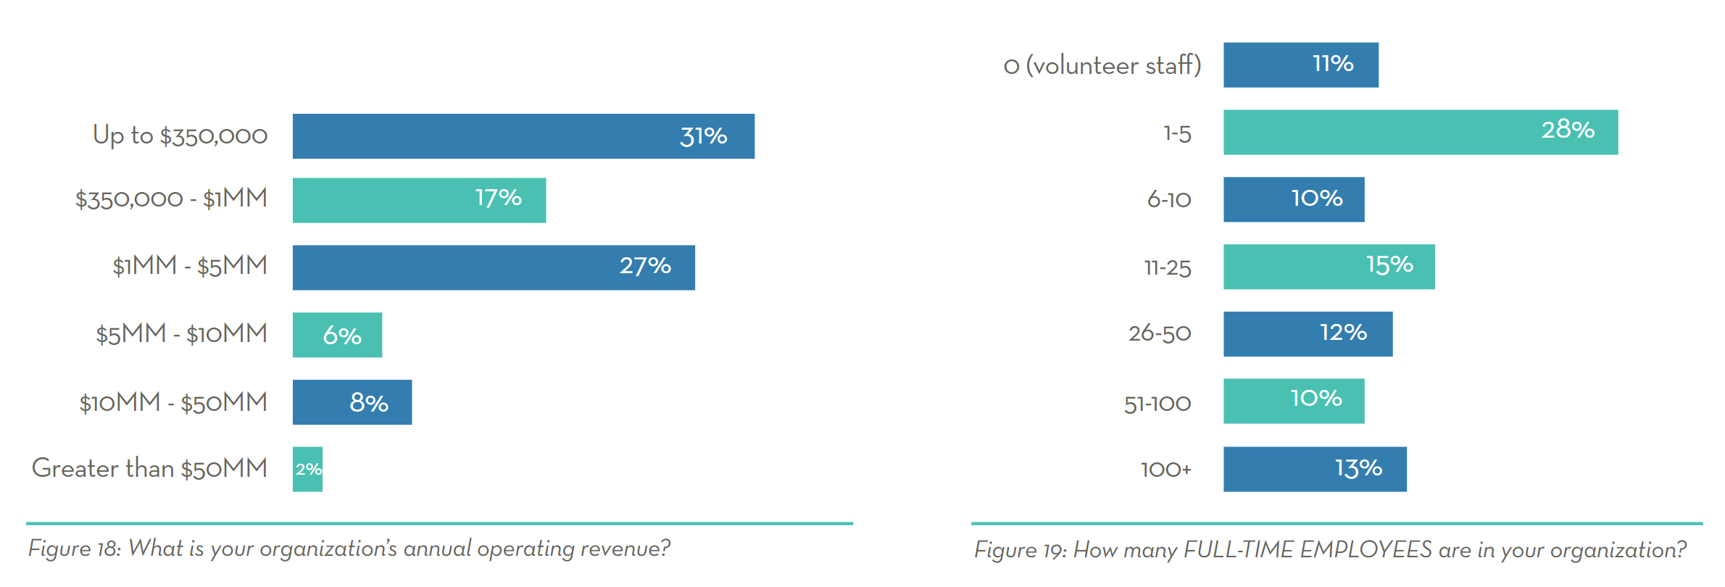
About the Report
890
Nonprofit Pros
Surveyed
Notes:
NAME
Every year, OneCause sends out a fundraising survey. For the past three years, we’ve used those results to create our Fundraising Outlook reports.
For the 2023 Outlook Report:
Our sample size was 890 nonprofit professionals – we removed duplicates from the same organization.
The survey was in the field in September of 2022.
NAME
Survey respondents represent a wide spectrum of organization sizes and verticals, with the majority or orgs falling into the range of annual operating revenues of less than $5 million.​
Most respondents identify their roles within executive, development, and event leadership, which means we have the right people—decision-makers—providing information for the report. ​
The nonprofits surveyed use a wide range of technology solutions and vendors to power their fundraising, not limited to OneCause – not just valuable for our 6,000 customers, but to the nonprofit world on the whole.
Cannot overstate how solid a study this is and continues to be over the years that OneCause has conducted this research.​ A major player in the nonprofit world publishes an annual nonprofit assessment … their US segment is typically 250. So to capture the voices of nearly 900 … pretty valuable view into the sector.​

Slide 5
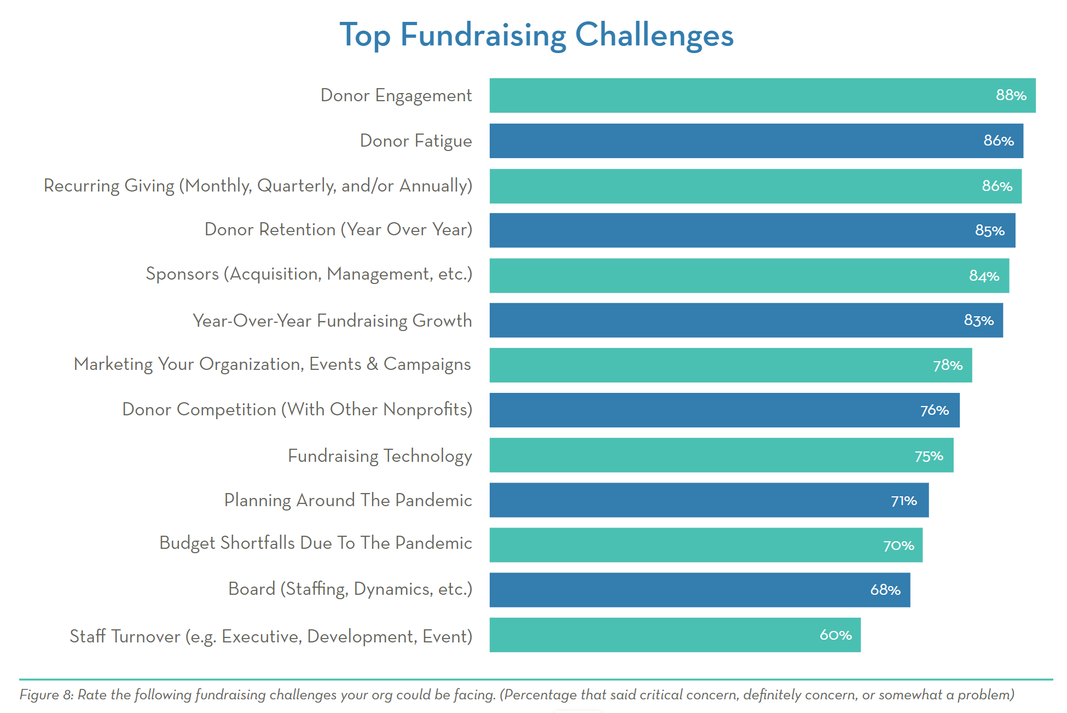
Top Fundraising Challenges
Notes:
NAME: TOUCH ON TOP 5 HERE –add some commentary on perception-based strategy around donor fatigue
Pressure from the pandemic continued to ease in 2022, with planning related to the pandemic as a challenge for nonprofits dropping from the number one spot in 2021 to number ten this year... and a drop of 19 points. Just because there was a drop doesn't mean it's no longer a concern—that still leaves around 70% of orgs reporting at least some concern in this area.
Top challenges impacting nonprofits this year included donor engagement, donor fatigue, and recurring giving.
Fundraising technology remained a challenge for approximately 3 in 4 organizations, the same as in 2021. In an increasingly saturated fundraising technology market, nonprofits are looking for differentiators that make giving fast, easy, and personalized.
NAME:
It’s interesting, though perhaps not a surprise, that intensity of challenge that nonprofits face is increasing. How do we arrive at this?
If you follow the running YOY average across all 13 challenges, that average is higher this year compared to 2021. And that 2021 average was higher than 2020.
One final comment: It’s interesting that in …
2020: COVID budget
2021: COVID planning
COVID now ranked as 10th and 11th – .
We are back to those donor-oriented challenges: engagement, fatigue, recurring giving, retention. Those are challenges that we can truly influence. We can take reasonable steps to address.

Slide 6


Paradigm Shift
New Online Formats
Reaching Donors Where They Were
Giving Donors Choice
Notes:
NAME
I know many of you shudder now at the term virtual pivot. But that’s what it was – that was the reality of the early days of the pandemic.
It became in pandemic fundraising a motto – WE HAVE TO MEET AND REACH THE DONORS WHERE THEY ARE. At home, on their computers, laptops, phones and engage them in our causes, campaigns, and events.
In the first few weeks and months of the pandemic nonprofits were cobbling together solutions, mobile fundraising with youtube live or facebook live, even zoom.
And during the pandemic, there was a big shift in donor expectations….

Slide 7

New Giving Expectations
MISSION & IMPACT
EXPERIENCE
CHOICE &
PERSONALIZATION
EASE & CONVENIENCE
#socialdonors
Notes:
There is a new giving experience born from the pandemic, and influenced by real-life consumer expectations. The experience centers on CHOICE, CONVENIENCE, MISSION & IMPACT.
Donors want the same quick, easy options for online giving that they became accustomed to from major online retailers like Amazon during the pandemic.
Not only were those consumer experiences quick and easy, they also offered choice and personalization—think about the convenience of being able to pick your delivery time for a purchase.
And in economically iffy times, donors want to know their money is going to good use—they want to see their impact.

Slide 8

CHALLENGES:
DONOR FATIGUE &
DONOR ENGAGEMENT
Notes:
You may be wondering why these are on the same slide… and I promise we’ll get to that.

Slide 9


Donor Fatigue & Donor Engagement
May be referred to as compassion fatigue
Reduced willingness to give influenced by:
  Economic conditions
  Frequency of asks
  Perceived effectiveness of nonprofits
  Sense of overwhelming need
Notes:
First, let’s run through a quick definition of donor fatigue
It may also be referred to as compassion fatigue
And it’s a reduced willingness to give influenced by things like economic conditions, frequency of asks, perceived effectiveness of nonprofits, and an overwhelming sense of need
There’s an ever-present debate in the nonprofit space as to whether or not donor fatigue is real.
We’re on team “It’s real,” but there’s definitely a perception issue and a disconnect between donors and nonprofits.
And that’s what we call FUNDRAISER fatigue. You’re SO CLOSE to your mission, and you’re constantly looking for new ways to engage donors, to make your appeals more effective, and to get the word out about your work that it FEELS like you’re always asking. It colors your view of donors’ mindsets.
During the pandemic, it seemed that every nonprofit was worried about fatiguing their donors…and some of that had to do with the incredibly fatigue fundraisers themselves were feeling. But what we saw with giving was the opposite: people wanted to help—they just needed to be asked, and they needed to see how donations would be put to good use.
And that impact piece is something we want to touch on and part of the reason we included donor engagement and donor fatigue together.

Slide 10
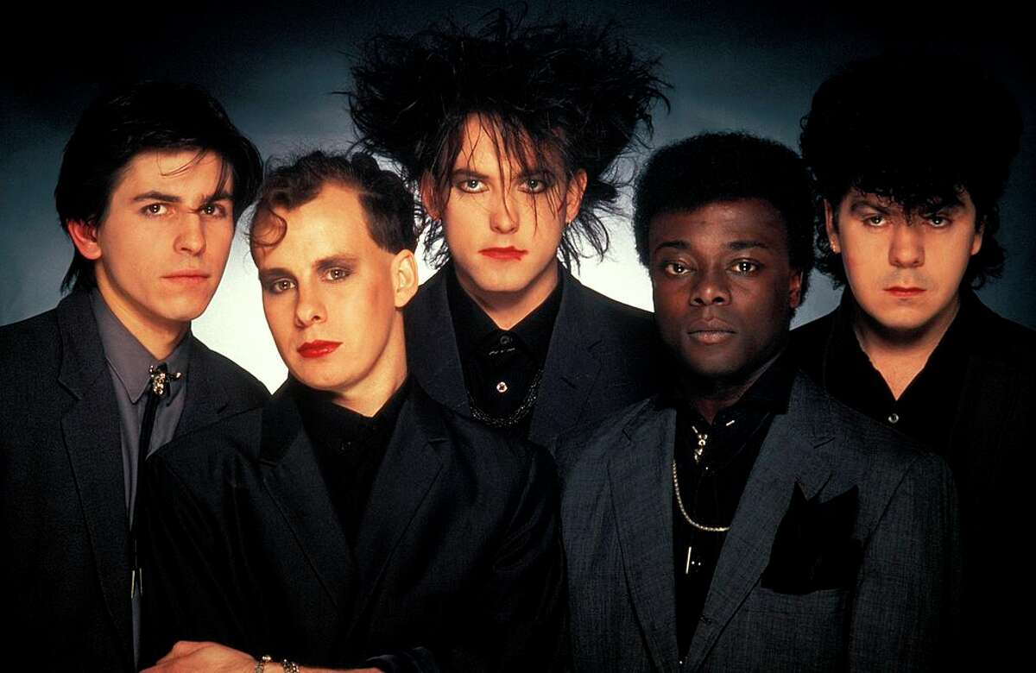
The Cure
Notes:
So, what’s the cure for donor fatigue?
Sorry, we had to…

Slide 11
ENGAGED DONORS ARE
NOT FATIGUED DONORS
#socialdonors
Notes:
Say it with me… engaged donors are not fatigued donors.
Donors want to hear from you….
If the communications they’re receiving are worthwhile and engaging, they won't be fatigued!

Slide 12
Donor Engagement: Impact
53%
“I knew the money raised would make a difference.”
Notes:
Over half of donors surveyed in our 2022 Giving Experience study said they gave because they knew how their money would make a difference.
SEEING IMPACT IS ENGAGING AND REDUCES COMPASSION FATIGUE.
Impact does NOT just have to be in your thank-you letters or your quarterly newsletters. Put your impact directly in your appeals. On your donation forms. On your event fundraising pages.

Slide 13
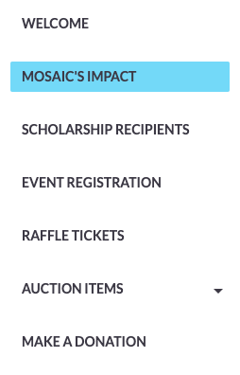


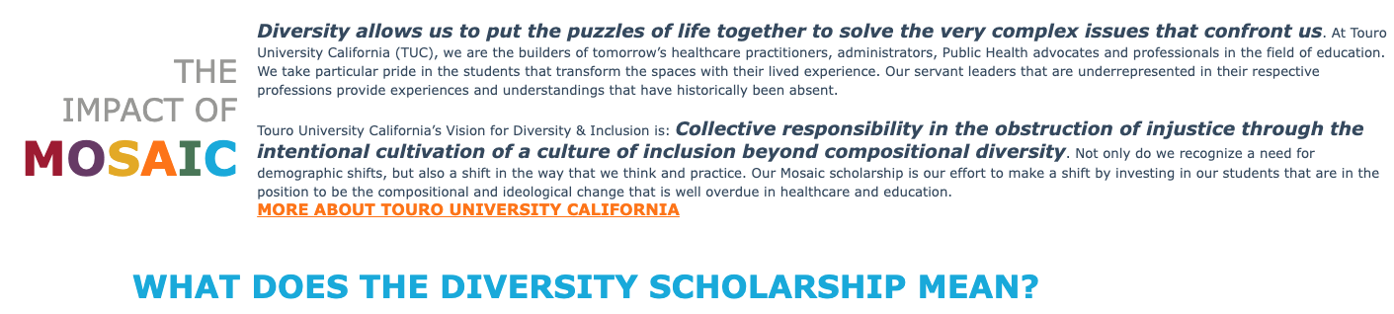
Donor Engagement: Impact
Notes:
Here’s an example from one of Touro University of California’s event pages.
For their Mosaic Celebration Diversity Scholarship Fundraiser, they created a dedicated impact page for visitors to their event registration page.
They made this really easy to find in their event page navigation. Anyone looking to register, purchase a raffle ticket, or make a donation could clearly see the Impact page and visit to find out more.
So what was on the page?

Slide 14
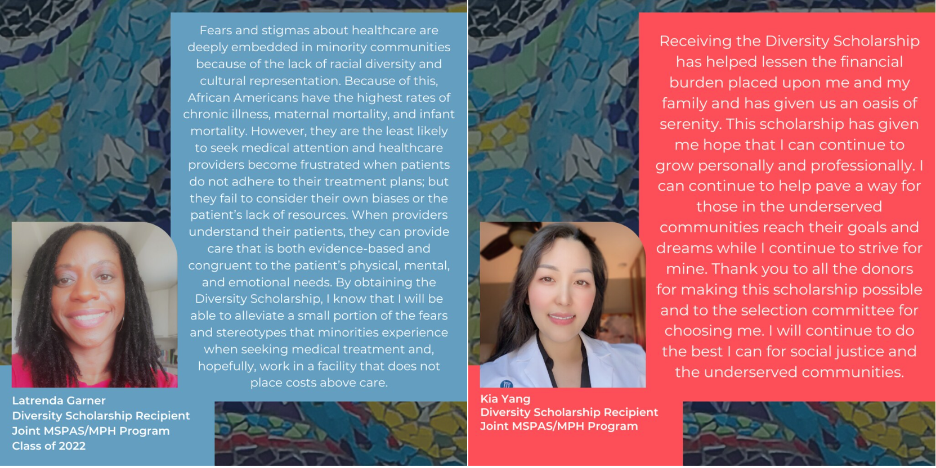
Donor Engagement: Impact
Notes:
Testimonials from students who received the Diversity Scholarship for which they were raising funds.
Not only did these testimonials show the DIRECT impact of donations on INDIVIDUAL PEOPLE, the testimonials themselves shared how the scholarship would benefit COMMUNITIES.
In Latrenda’s testimonial, she said receiving this scholarship for her Master of Science in Physician Assistant Studies and Master of Public Health will allow her to alleviate some of the fear and stereotypes that minorities experience when seeking medical treatment.
Kia states that she can continue to help pave a way for those in underserved communities to reach their goals while she continues to strive for hers. And she thanks donors.

Slide 15
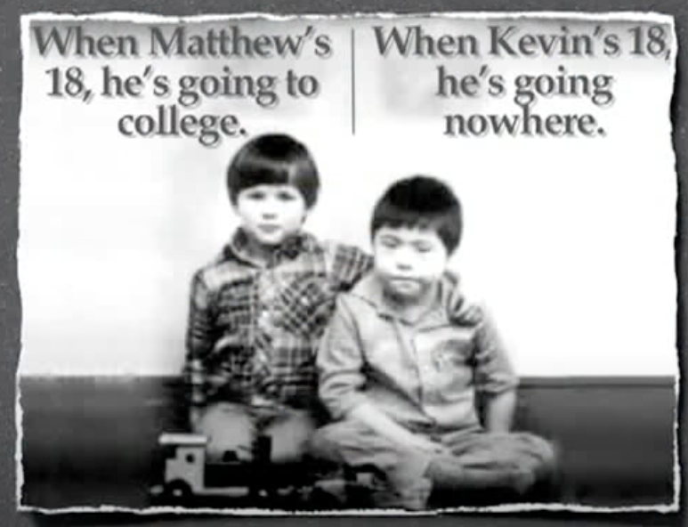
Donor Engagement: Messaging
DON’T do this
Pity-based fundraising is no longer acceptable
It’s proven that donor response to positive appeals is strong
Notes:
There’s definitely a right way and a wrong way to engage donors in your communications, especially in your appeals.
This is the wrong way. Pity-based fundraising appeals are no longer okay. And while I assume pretty much everyone here knows that, it never hurts to emphasize it.
Do you remember the days when you’d see pity-based fundraising commercials on television MULTIPLE times a day? And do you remember getting exhausted and changing the channel after the third time you saw it because it felt hopeless?
Not ONLY does this type of imagery cause major compassion fatigue, it also strips subjects of their dignity.
This example leads to a happy ending…

Slide 16
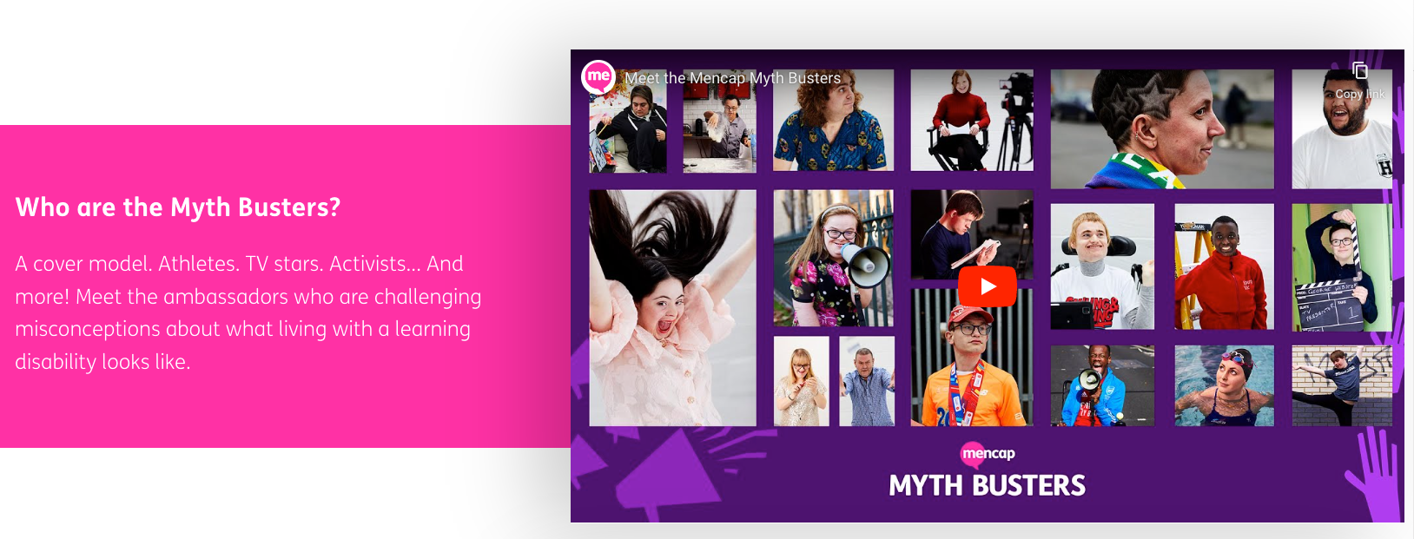
Donor Engagement: Messaging
DO this:
Notes:
…it’s from a British organization called Mencap. The previous image is very old, but it shows how far they’ve come. Here’s a screenshot from their website a couple of weeks ago. They now have the Mencap Myth Busters, spokespeople with disabilities who come from all walks of life and are challenging misconceptions about what living with a learning disability looks like.
There’s a short documentary by Drew Morton Goldsmith available on YouTube that shows the “Before” example – we’ll include the link on the last slide for you.
Let’s look at one more example of doing it right.

Slide 17

Donor Engagement: Messaging
Omnichannel = Omnipresent
Notes:
Multichannel AKA omni channel marketing has changed fundraising—the ability to reach people with the right message at the right time and on the right channel is an art and yield amazing results.
But the very nature of omnichannel messaging and marketing means that people are constantly inundated with emails, banner ads, social media ads, commercials interrupting their videos, and text messages – and that’s something you’ve got to keep in mind when seeking to engage donors with your marketing and communications in order to combat fatigue
Think about ALL of the places donors might see your communications, your appeals, your asks across channels.
It’s great if they see you on all of those channels… but are they seeing the exact same message and image every time they see you? Are they reading “Your $25 dollar donation could save a life” over and over and over again?
That’s not effective! People viewing your communication should be served a variety of messages as they move through various stages of awareness of your mission.

Slide 18
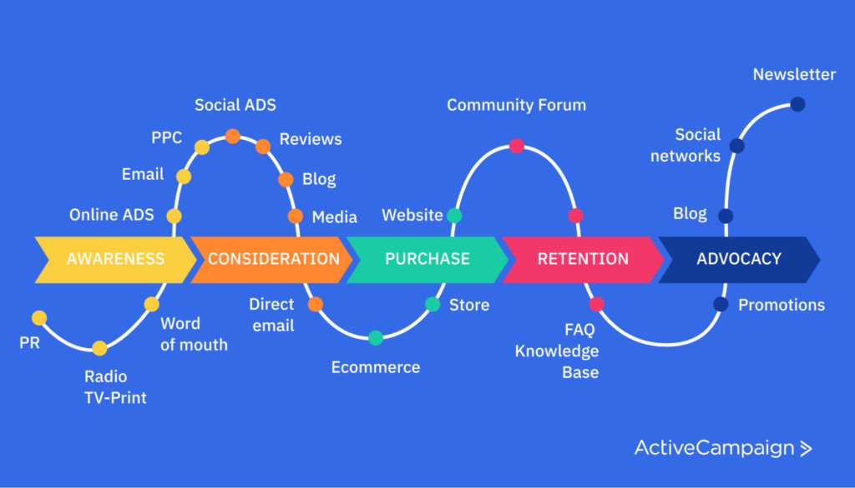
Donor Engagement: Messaging
Notes:
Multichannel marketing has changed fundraising—the ability to reach people with the right message at the right time and on the right channel is an art and yield amazing results.
But the very nature of omnichannel messaging and marketing means that people are constantly inundated with emails, banner ads, social media ads, commercials interrupting their videos, and text messages – and that’s something you’ve got to keep in mind when seeking to engage donors with your marketing and communications in order to combat fatigue
Think about ALL of the places donors might see your communications, your appeals, your asks across channels.
It’s great if they see you on all of those channels… but are they seeing the exact same message and image every time they see you? Are they reading “Your $25 dollar donation could save a life” over and over and over again?
That’s not effective! People viewing your communication should be served a variety of messages as they move through stages of the customer journey—this is the perfect way to view what communications donors at varying stages of involvement with your mission should receive.. How?

Slide 19












The Giving Experience
A NEW LOOK AT EASE & SELF-CURATION
CHECK-IN
PROGRAMMING
CHECK-OUT
MOBILE BID
PADDLE
RAISE
IN-PERSON SUPPORTER
REGISTRATION
In-person ticket package
ON SITE ANNOUNCEMENTS
PROMOTION
PRE-EVENT FUNDRAISING
EVENT
START
ONSITE FUNDRAISING
EVENT
END
REGISTRATION
PROGRAMMING
VIRTUAL SUPPORTER
Party in place packages
ONLINE DONATION
LOG-IN
DIGITAL ANNOUNCEMENTS
CHECK-OUT
$
Notes:
Donor engagement for year-round fundraising is one thing… but what about engagement DURING your fundraising events? That’s not something to overlook.
And if you’re hosting a hybrid event, you’ll need to engage donors in TWO audiences….from programming to supporter communications and the overall giving process.
So, how do you do that?

Slide 20
Donor Engagement: Events
Text messaging (leading up to event, segmentation)
Chat during events (live and virtual)
Remote bidding
Gamification
Ambassador fundraising
Notes:
Need images to speak to for this slide

Slide 21
CHALLENGE:
RECURRING GIVING

Slide 22

Recurring Giving
Converting one-time donors
Marketing your recurring giving
How you communicate with recurring donors
Notes:
86% of nonprofits surveyed in the Outlook Report said they faced recurring giving challenges.
And some of the most common issues recurring giving are getting that actual conversion from one-time to recurring donor (no surprise there!), a lack of marketing and promotion of one’s recurring giving program, and truly differentiating how you communicate with your one-time donors compared to your recurring donors

Slide 23
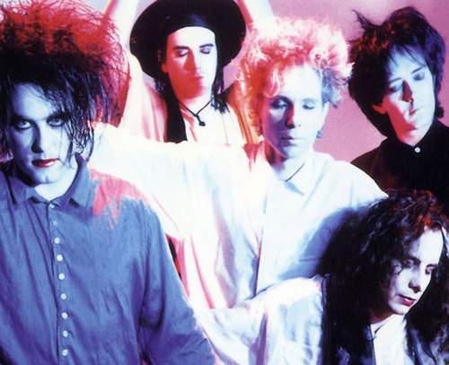
THE CURE

Slide 24
Recurring Giving
58%
“It was easy to do.”
Notes:
In the 2022 Giving Experience Study, nearly 60% of donors said one of the reasons they gave was because it was EASY.
This is especially important for recurring donations.
Alas, unlike in Field of Dreams…. Just because you build it does NOT mean they will come
When you start a recurring giving program, you have to promote it to make it EASY for donors to learn about your recurring options and to find where to set up a donation.
When people go to your website, do they see anything promoting your recurring giving program?
Do you ask one-time donors to upgrade their gift before they submit their payment information?
If they receive an appeal in the mail, do they see a recurring giving option on your remittance slip?
Is there a section in your email newsletter that highlights your recurring giving program?
Where can it go on website, where can it go in print materials, emails, etc.

Slide 25
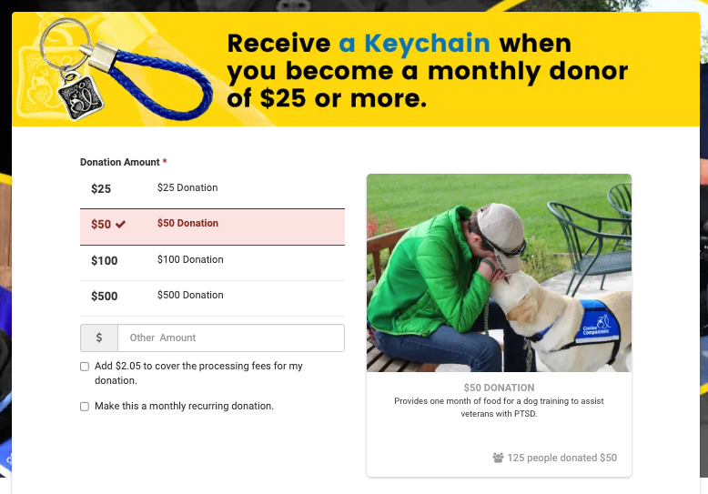
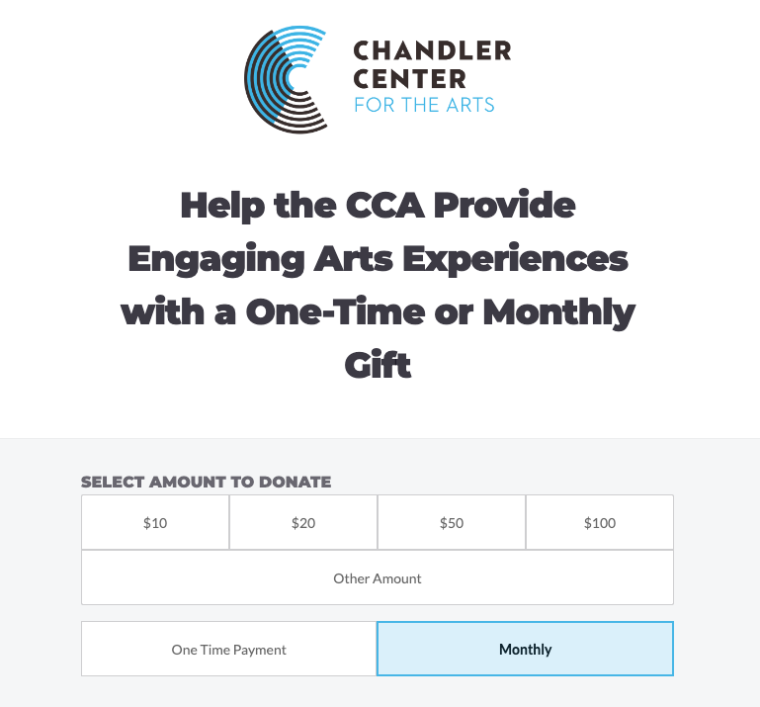
Recurring Giving
Notes:
Once they land on your donation form, things should be easy as well.
Imagine you’re visiting this donation form on the right for the first time. I IMMEDIATELY see that I can make a monthly donation.
If you have a dedicated form for recurring giving, make sure it’s incredibly clear in your website navigation or on your homepage that donors can make a one-time or recurring donation.
Remember when we talked about impact with our last challenge? It’s back!
Visual and written impact statements can help donors better understand the effect their gifts have.
Canine Companions used this recurring giving form on the left to show monthly donors what each level of giving impacts.

Slide 26

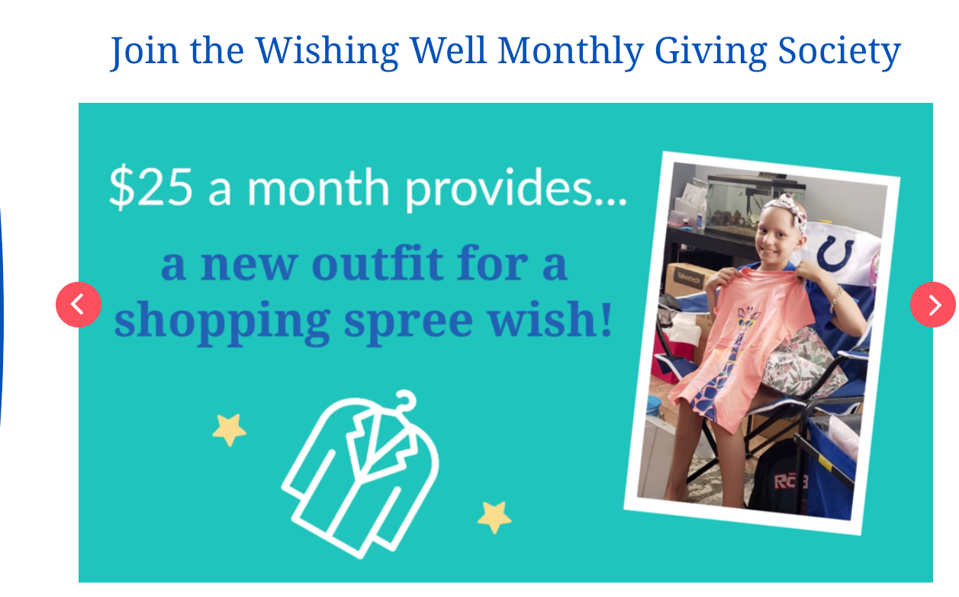
Recurring Giving
How are you talking to your recurring donors?
Start with a thank you
Make them feel like VIPs (because they are)
Keep communicating
It’s okay to ask for more
Notes:
Part of the struggle with recurring giving is not just conversion, but with how nonprofits communicate with recurring donors.
These are your most loyal supporters. They’ve gone above and beyond to set up a sustaining gift withy you. You owe them extra-special treatment!
Personal phone calls go a long way—they add a personal touch, and really do leave donors with a case of the warm fuzzies.
The extra effort recurring donors put in deserves to be recognized in an ongoing way. One way this can be done is to create a special group just for your recurring donors.
Make-A-Wish Foundation created the Wishing Well Monthly Giving Society and has a dedicated page on their website that shares impact of giving levels.
And when recurring donors convert… you might be tempted to back off on communication to them. But don’t do that!
You just have to think about HOW you’re communication to them… don’t take them off your mailing lists. Remember that your recurring donors are part of a special group, so segmenting their communication is vital. They won’t get the same emails and asks as your one-time donors, they won’t receive your recurring campaign emails…. But they should definitely be getting frequent impact updates. You can even consider creating a newsletter or report that’s specifically for your recurring donors. And of course, they can still receive appeals for your major campaigns.
…and if you’re providing frequent impact, thanking recurring donors, and providing ongoing recognition… don’t be afraid to ask them to upgrade their gift!
If you have a donor who has been giving $20 a month for a year, try asking for a $5 or $10 increase a month—that can add up to an additional $60 to $120 every year. And if you have a number of donors giving at that level that you can successfully upgrade, that’s a significant amount of extra funds.

Slide 27
Use Your Data
Notes:
And make sure you’re using the data you have available to you to strategically market your recurring giving program.
In your CRM (or your online fundraising technology’s reporting system) you can identify donors who have given to your organization multiple times in a year but who have not signed up for a recurring donation.
You can then create a targeted campaign to upgrade these donors. An email campaign is fine, but if you have the resources, calling may be even better.
We have a teammate who loves to share a story about how a nonprofit she donates to a few times a year called to thank her for her frequent support and asked if she’d be interested in setting up a recurring donation.

Slide 28
CHALLENGE:
DONOR RETENTION
Notes:
Next up…donor retention
85% of nonprofits surveyed for the Fundraising Outlook report said this was a challenge.

Slide 29
Donor Retention
40-45%
Notes:
We all know donor retention is important… and we all know the stats surrounding it are not super impressive.
Annual donor retention hovers around 40-45% across the industry
Efforts on retention are incredibly important because…

Slide 30
Donor Retention
Donor retention > donor acquisition
  Acquiring a new donor can cost 50-100% more than retaining a current donor
  Lifetime value of retained donors is significant
  Retained donors = major gift donors
Retained Donor | One-time Donor
Gives $250 dollars every Christmas | Gives $1,000 once
Annual gift starting at age 30 | Once in response to need
10 years: $2,500
20 years: $5,000
30 years: $7,500
Notes:
1) The cost to acquire a new donor is SO MUCH higher than the cost of retaining a donor – new donors can cost you 50 to 100% more than a retained donor
2) The lifetime value of a retained donor, even a small-dollar direct mail donor, can really add up. So engaging donors and building those relationships is going to pay off big-time in the long run. If you can retain more donors like the one on the left above (and maybe get them set up on an annual recurring donation plan… or even a $25/month donation that brings their lifetime total up to $9,000), you’ll set yourself up for a much more reliable revenue stream.
AND in a study co-sponsored by Bloomerang and Donor Search, they found that most major gifts came from retained donors who had been giving to an organization for five or more years.

Slide 31
THE CURE
Notes:
So, what’s the cure for donor fatigue?
Sorry, we had to…

Slide 32
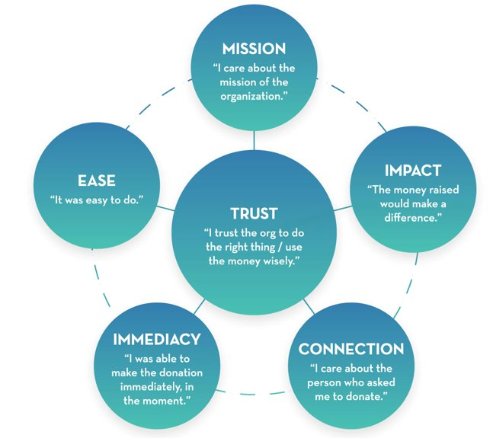
Donor Retention
40-45%
Notes:
Tactics:
In our 2022 Giving Experience Study, we asked donors what motivated them to give. The number one reason donors said they gave was because they trusted an organization. And if someone trusts your nonprofit, they’re likely to give to you again. And it’s likely that you’ve done all of the things on the outer circle of this generosity motivator ecosystem graphic to build that trust that will ultimately retain donors.
Effectively retaining your donors takes more than just one tactic. If any spoke on this wheel weakens, your donors’ trust in you starts to erode.
Are you making it EASY for people to give on your website, to your giving day pages, on your event pages before, during, or even after an event?
Are people able to make a donation when and where they want to—like from their cell phones?
Are you effectively sharing your mission in your communications and conveying your impact in multiple places?
Are you creating a sense of connection between you and your donors, and amongst your communicty of donors themselves?

Slide 33
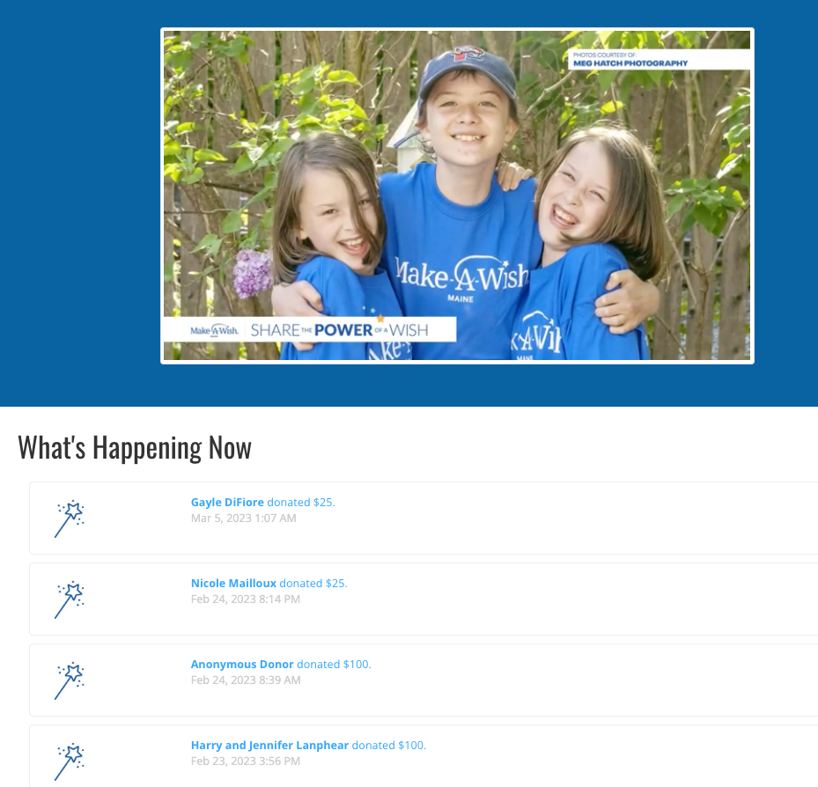
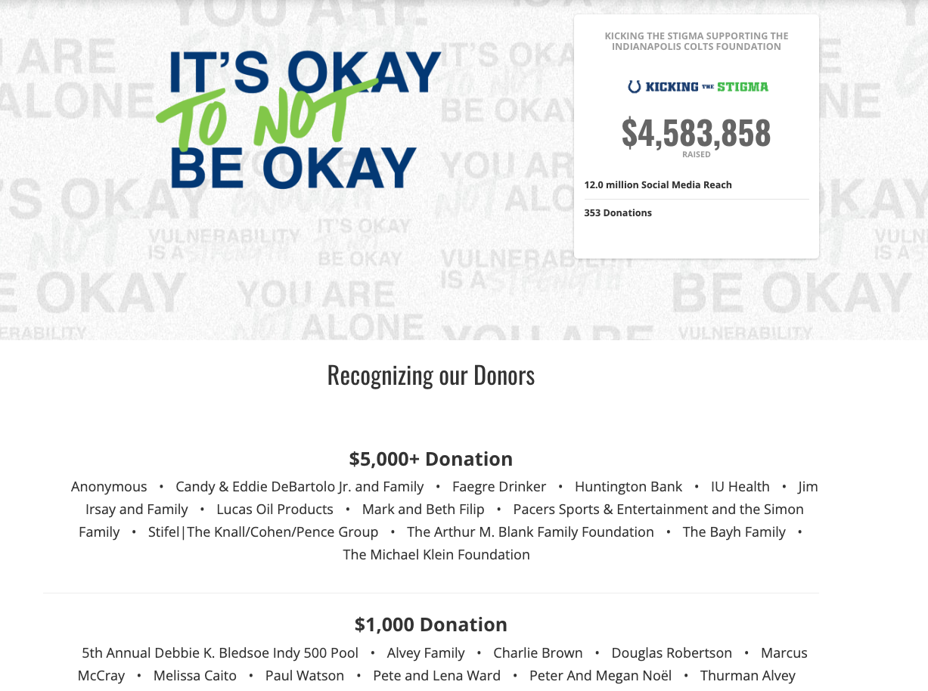
Notes:
We all know thanking donors is important. Yes, your donors should immediately receive a thank-you receipt when they make a donation online… but how else can you USE TECHNOLOGY to help you retain your donors?
If your giving platform offers a donor activity feed or a donor wall, make use of it to recognize donors. Send a link in your campaign update emails!
Coupe of examples here: on the left is a giving timeline from Make-A-Wish Maine
And on the right is a donor wall example from the Indianapolis Colts Foundation

Slide 34
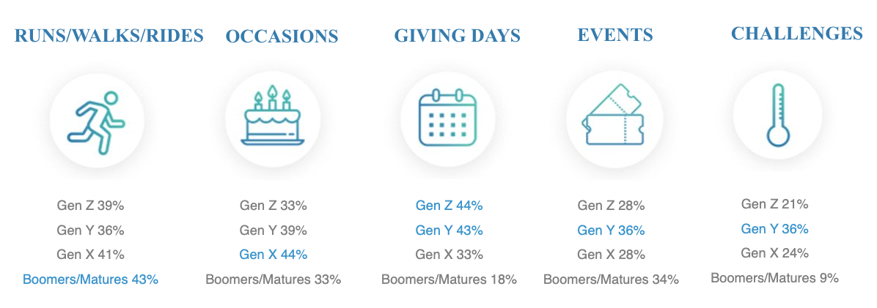
 | AAPI | Black | Hispanic | White
Mutual aid | 30% | 32% | 32% | 23%
Donated or requested donations for a specific giving day/month | 37% | 50% | 47% | 26%
Donated or requested donations for an occasion (birthday or in memorial/tribute) | 37% | 33% | 45% | 38%
Donated or participated in a fundraising challenge | 30% | 29% | 31% | 21%
Donated directly to an organization | 62% | 59% | 60% | 74%
Notes:
We hear a lot about surveying donors to find out their preferences. And usually, that applies to their preferences for how you communicate with them.
But to retain more donors, are you paying attention to how they prefer to engage with your organization… how different demographics want to participate in fundraising and giving?
The data here came from our 2022 Giving Experience Study
The top graphic breaks down participation in different types of social fundraising campaigns broken out by generation. Looking to appeal to younger donors? Consider hosting a giving day or creating a campaign around an existing giving day?
Want to get Millennials involved? Try a fundraising challenge.
The bottom graphic shows data on types of fundraising support broken out by race.
Different groups want to participate in different ways… and offering those options will help you attract and retain more diverse donors.

Slide 35
CHALLENGE:
SPONSORS

Slide 36
Sponsors
Finding the right fit
Sponsors perceive a one-sided relationship
Is your impact clear?
Notes:
And our last challenge for today is… sponsors. How many of you struggle with securing sponsors?
Many nonprofits say it’s tough to find the right fit – they may not have done due diligence by ensuring org mission and company vlaues align
Oftentimes sponsors see sponsorships as a one-sided relationship---they’re providing money… and what do they get in return? Are you sharing impact, providing ROI?

Slide 37
THE CURE
Notes:
So, what’s the cure for donor fatigue?
Sorry, we had to…

Slide 38
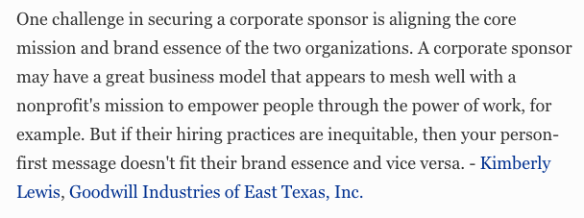
Sponsors: Find a Fit
Notes:
It is well worth your time to research potential corporate sponsors to ensure your mission and values align. It’s not a bad idea to check for bad press, either.
You don’t want to wind up in tied to a company that simply isn’t a good fit

Slide 39
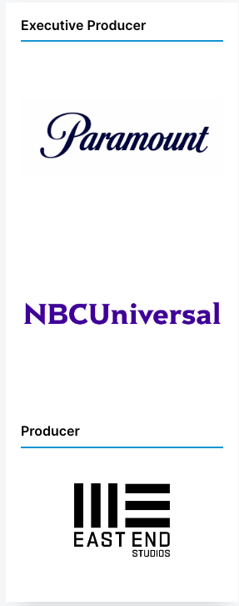
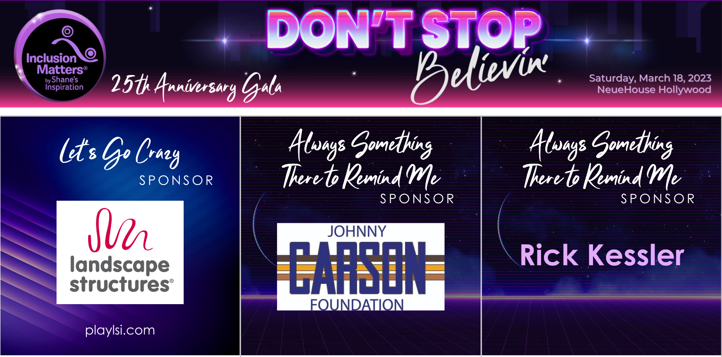
Sponsors: Demonstrate ROI
Notes:
You can TELL sponsors that they’ll get a return on their investment, but how can you demonstrate ROI, especially in your fundraising tools?
Inclusion Matters created a Meet the Sponors page for their 80s-themed Don’t Stop Believin’ Gala. Each tile contains a clickable sponsor logo that takes visitors to the sponsor’s homepage.
And another simple example from Reelworks with clickable logos sorted into sponsorship levels.

Slide 40
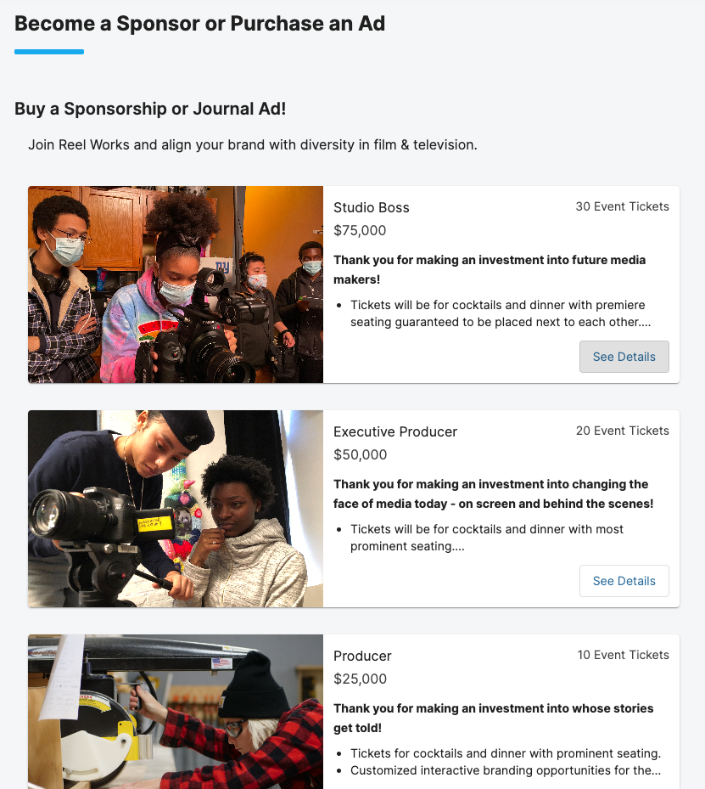
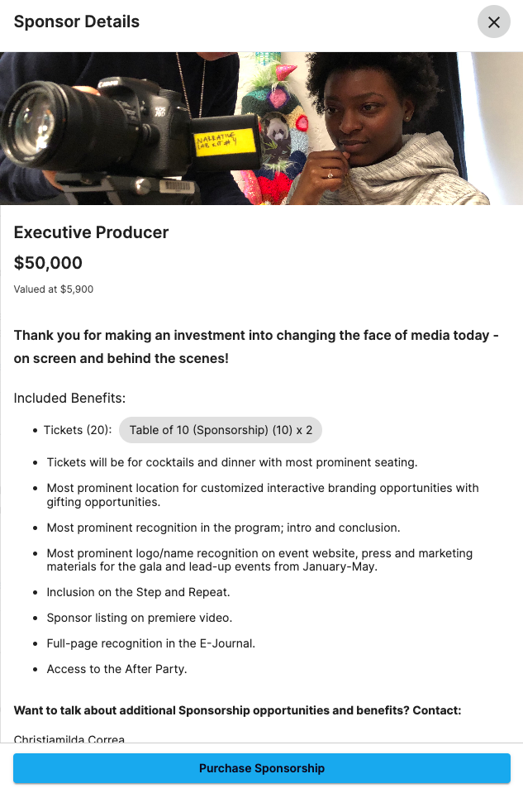
Notes:
And Reel Works provided flexible online sponsorship ticketing to meet a range of sponsor needs
Each sponsorship level contains a clear list of items to demonstrate ROI before sponsors commit.

Slide 41
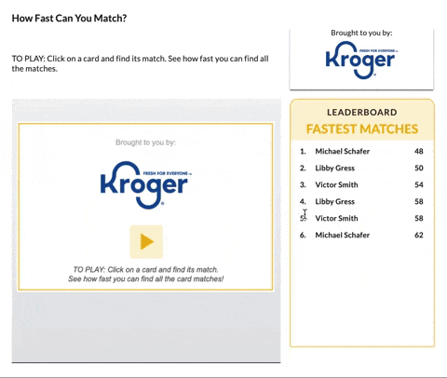
Notes:
You can even gamify sponsor exposure, like with this sponsor memory match game supporters can play.

Slide 42
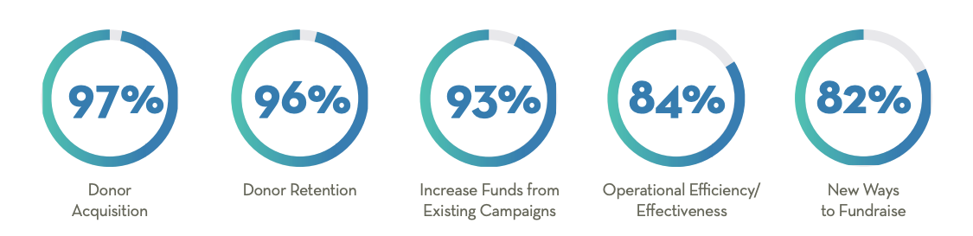
The Question of Priorities
Notes:
ADD POINTS ON how focusing challenge of donor retention can help solve for needing to focus so much on acquisition… and that incorporating new ways to fundraise (like some of the ways mentioned in donor retention section) can help solve for that donor acquisition problem.

Slide 43
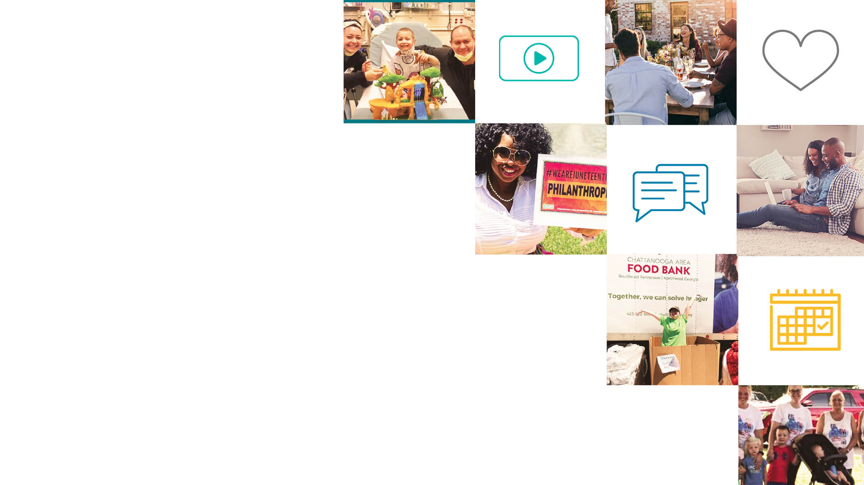
Interactive Breakout

Slide 44

Questions?

